Slide 1
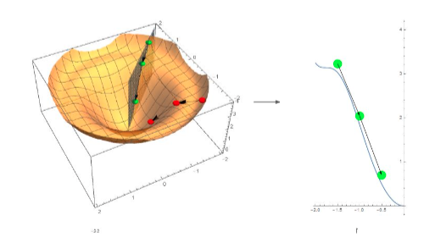
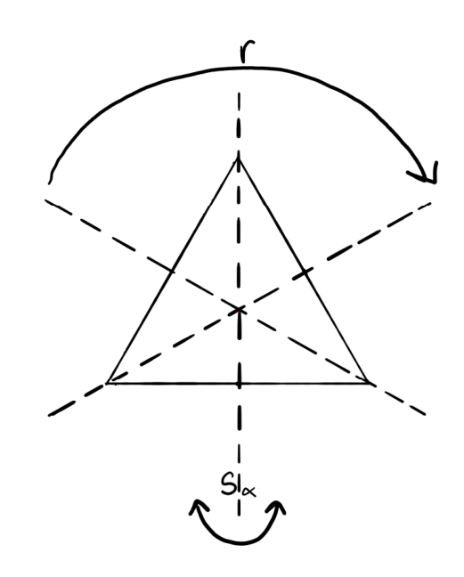
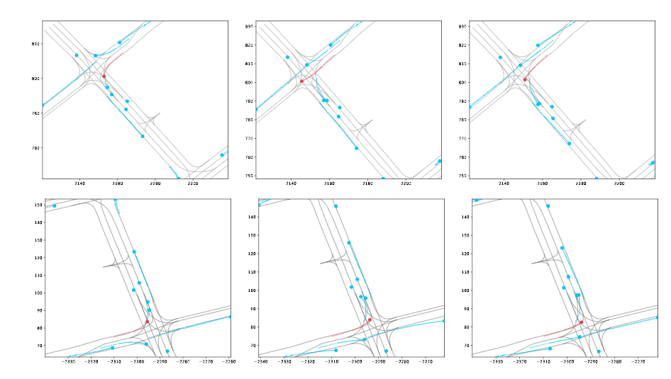
CS 7180: Geometric Deep Learning
Lecture 5: Introduction to Symmetry and Deep Learning

Slide 2
Limits of Unconstrained Neural Networks (MLP)
Potential Issues:
Overfitting: The function class F is too big. We may precisely fit the training sample S without finding the true function f. Poor generalization
Need a lot of parameters Ө
Need a large dataset S
Considering classes F with built-in symmetries can help address these issues.

Slide 3
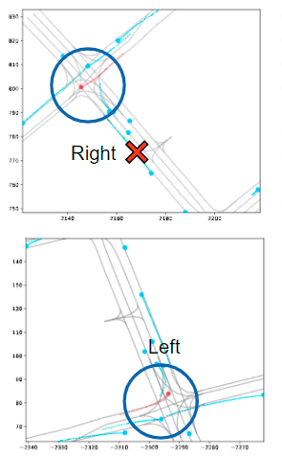

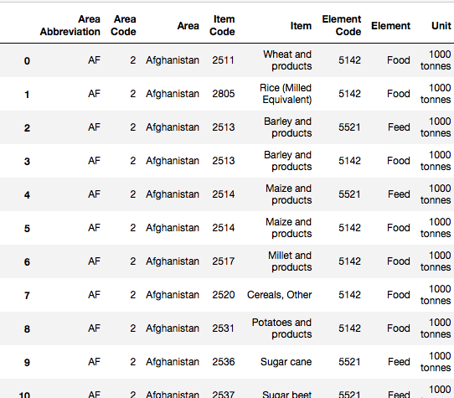
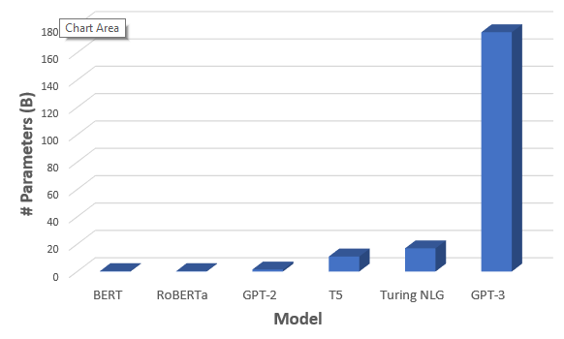

Limits of Current Methods in ML
Limited Generalizability
Data
Hungry
Huge
Models
Inconsistency &
Lack of Guarantees
Notes:
One frequent problem limiting machine learning’s practical impact is that many models do not perform well outside of a very narrow domain. For example, a model trained to perform ocean current prediction may fail to generalize to certain latitudes poorly represented in the training data.
Another limitation of today’s neural networks is that highly performing models may require large amounts of data to train. This may not be an issue for amazon product recommendations, but what about situations in which data is inherent limited such as diagnosing rare illnesses? In these cases, we need models which can learn from fewer data samples.
Next we have the issue of neural network size. Recently neural networks have grown into the range of 100s of billions of parameters. Training and running inference using these networks is thus out of range for all but large companies or organizations. We thus need smaller more efficient versions of these models.
Lastly, in certain critical applications, the black box nature of learned models is itself a problem. In general most models operate without guaranteed constraints, and thus may give nonsense outputs at key moments where much depends on their outputs. Consider the example of vehicle trajectory prediction in which an incorrect prediction could lead to a collision. We would like to able to guarantee that the output of the model does not fundamentally depend on the orientation of data, but in general, for most neural networks, even this level on consistency cannot be guaranteed.

Slide 4
Symmetry in Machine Learning
Limited Generalizability
Limited Generalizability
Data
Hungry
Huge
Models
Huge
Models
Inconsistency &
Lack of Guarantees
Inconsistency &
Lack of Guarantees
Incorporate symmetry as inductive bias into neural networks
Generalize across symmetry
Generalize across symmetry
Automatic Data
Augmentation
Automatic Data
Augmentation
Weight
Sharing
Weight
Sharing
Provable Performance
Provable Performance
Notes:
my work seeks to address these key limitations in ML using symmetry. By incorporating symmetry as an inductive bias into models, we can generalize better, learn using less data, create smaller models with fewer parameters, and impose strict constraints on models which guarantee some level on consistency in their outputs.

Slide 5
How to Incorporate Symmetry Into Neural Networks
Mathematical model
Extract symmetries
Build network constrained by symmetry
Train to model system
Provides a program for incorporating prior physical knowledge into deep learning.
Notes:
Now that we have discussed why incorporating symmetry may be useful in deep learning, let me explain how we go about getting symmetry into a neural network.
This chart describes at a high level my basic program for how to use symmetry to address problems.
In the first step we develop some mathematical model for the problem we want to study, for example a differential equation, or a difference equation, stochastic model, or MDP.
Then we example this mathematical model for any symmetries. These symmetries vary widely with the domain we consider, they may be discrete, continuous, bounded, unbounded, etc.
Next we design a neural network which directly incorporates these symmetries as a constraint. We have many different methods for doing this and they vary greatly with the kind of symmetry we are considering.
Lastly, we then train the NN and observe that usually the symmetries constraints result in a better performing model.
One advantage of this approach is that provides a way to leverage previous physical knowledge, often representing hundreds of years of understanding, into neural networks so that they don’t have to start over from scratch.

Slide 6
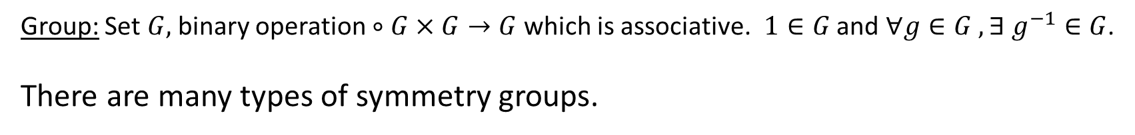
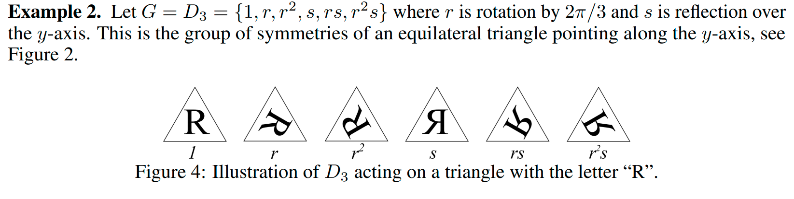
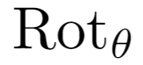

Formalizing Symmetry: Groups
Notes:
1. Cts symmetry vs. discrete symmetry. Dihedral group

Slide 7
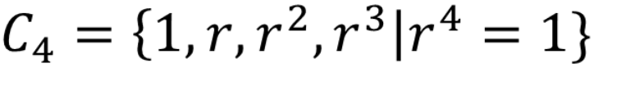
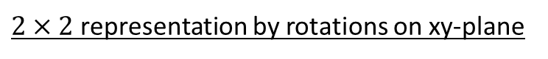
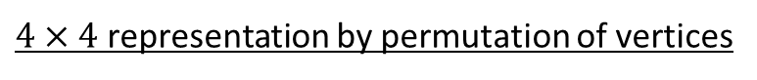
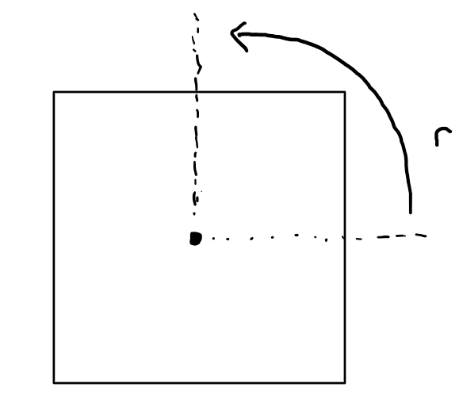
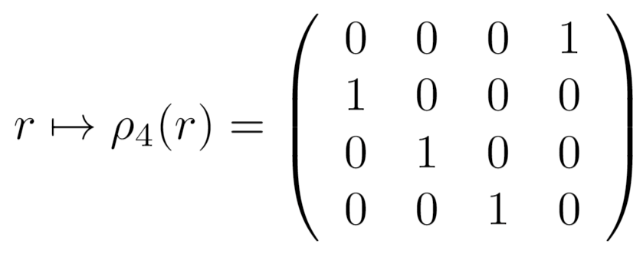
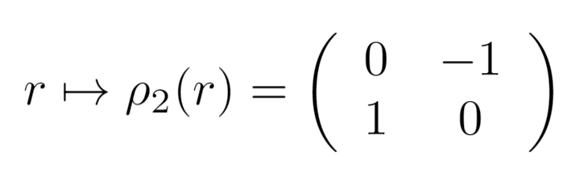
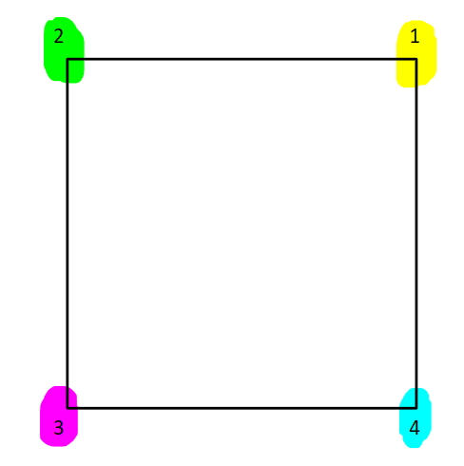
Formalizing Symmetry: Groups and Representations
Cyclic Group
r
2
1
1
3
4
Notes:
I will now explain the mathematics of symmetry and how we constrain networks to respect it.
Symmetry is described using abstract symmetry groups which contain sets of transformations which can be composed. Here we consider as an example the cyclic group of order 4. It is generated by an element r which when multiplied by itself 4 times becomes the identity.
This abstract symmetry group forms a template which can be instansiated in various concrete ways called representations. For example, here we see a 2-dimensional representation of C_4 in which r is represented by a 2x2 90 degree rotation matrix. Taking this matrix to the 4th power gives the identity
Another representation of this group is given by this 4x4 permutation matrix which cyclicly permutes the standard basis vectors of R^4. Again, we see raising this matrix to the forth power gives the identity matrix.

Slide 8
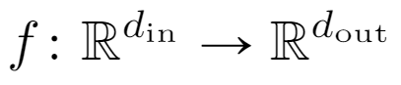
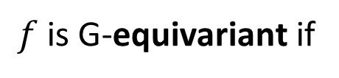
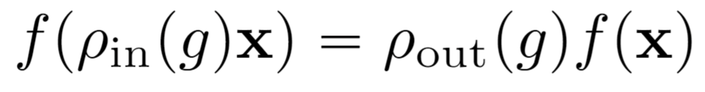
Equivariant Functions
Model functions which are equivariant with respect to symmetry group.
Notes:
The primary method by which we consider symmetry in deep learning is by identifying functions and tasks which are equivariant with respect to some symmetry. For example, consider the function f representing the image segmentation task in which pixels in the are labeled as belonging to a given object. This function represent a ground truth function we may wish to learn using a neural network. We can also see that this function satisfies a certain symmetry property. Namely when the input is rotated by 45 degrees the corresponding output is also transformed by 45 degrees. In general the representation of the rotation may be different in the input and output space, but here they happen to be equal. We call this property equivariance. If the input is transformed before applying the function f it is equal to first applying the function f and then transforming the output.
—--------------------------------------
image credit: https://ai.stanford.edu/~syyeung/cvweb/tutorial3.html

Slide 9

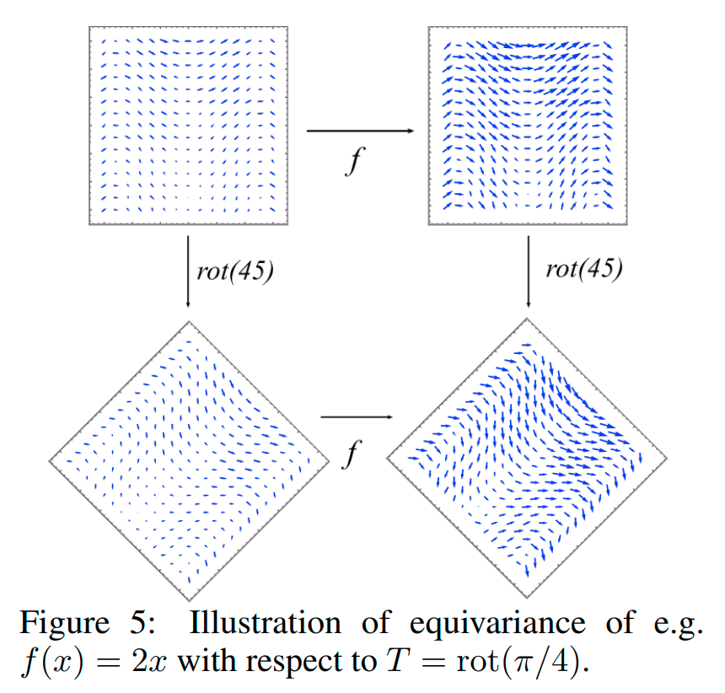
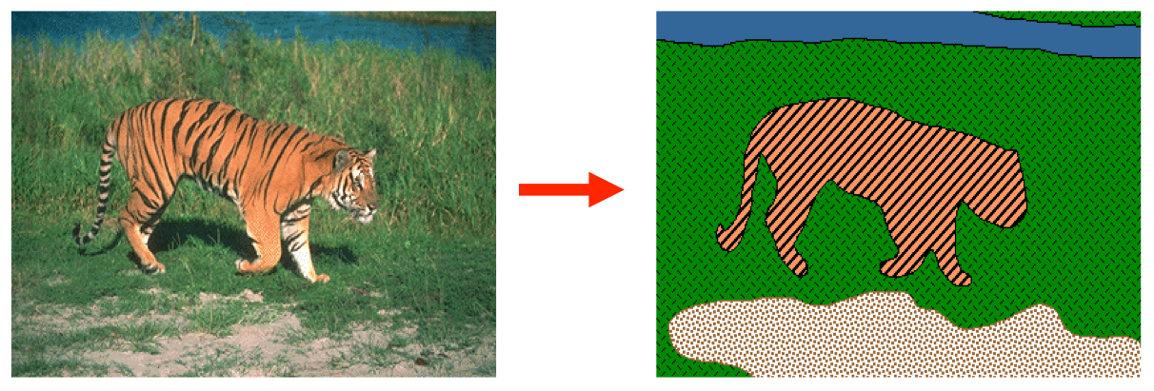

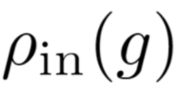
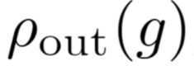
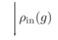
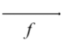
Translation Invariance and Equivariance
Rose
Segmentation: Equivariance
Labeling: Invariance
CNNs are a translation-equivariant model class for modeling these tasks.

Slide 10
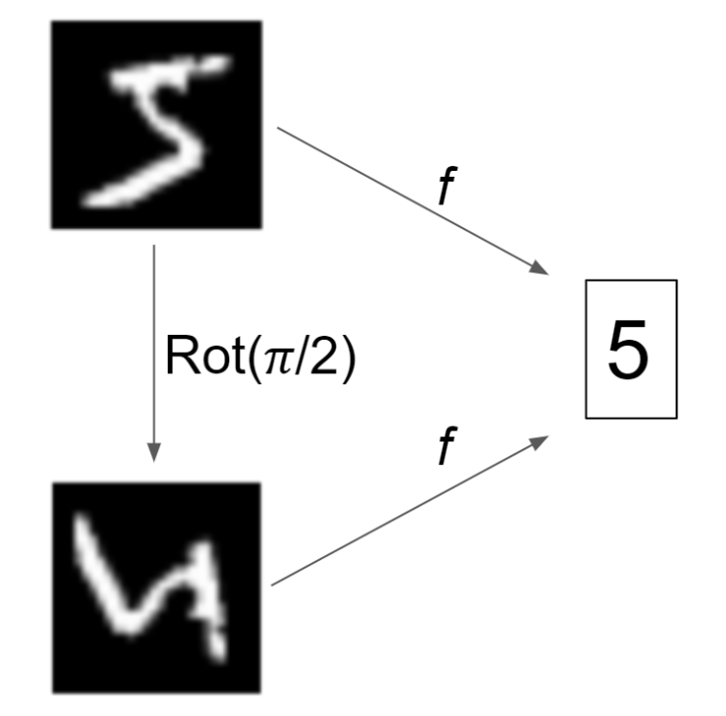
Rotation Invariance and Equivariance

Slide 11
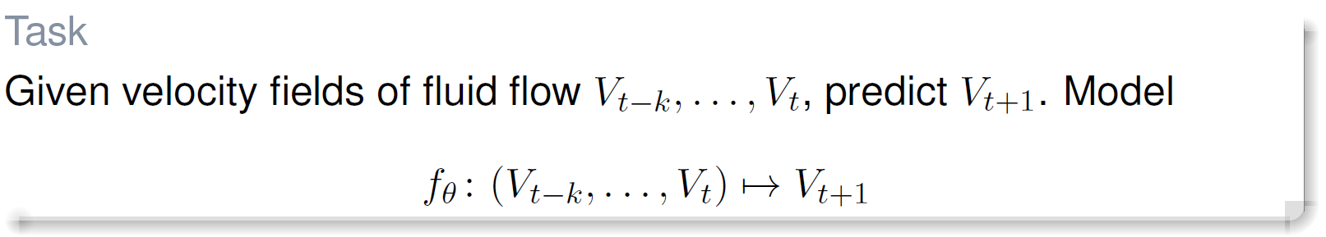
Predicting Turbulent Flow
Forecast velocity fields of fluid flow:
Numerical Solvers: For high accuracy, computationally intensive, require expert tuning.
Machine Learning: More efficient, operate on partial data, but have poor physical consistency (energy conservation).

Slide 12
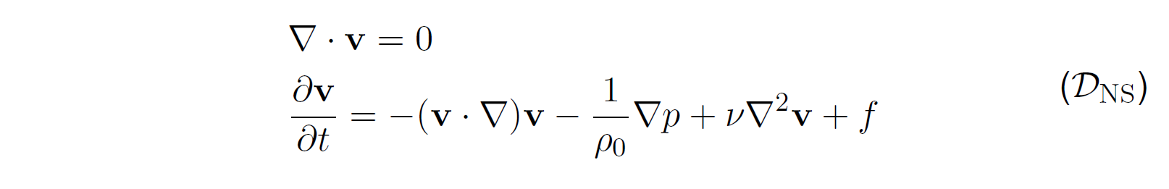
Fluid Flow and Symmetry
Navier Stokes Equation (Nonlinear PDE)
Has symmetries coming Galilean invariance and scaling laws.
The forward prediction function
is equivariant wrt these sym.

Slide 13
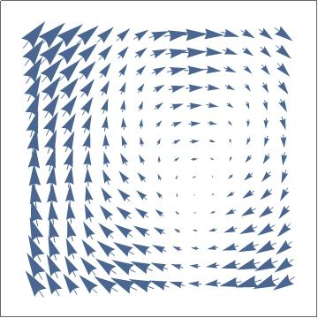
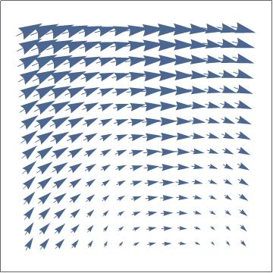
Symmetry: Galilean Invariance
independence of physics from arbitrary choice of coordinate system 🠆 Galilean invariance
Translation
Rotation
Uniform Motion
To a NN, these data all look very different
Notes:
Formulas in additional slides

Slide 14
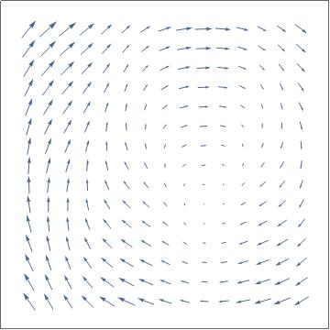
Symmetry: Scaling
t
t
Notes:
Image Credit: https://www.flickr.com/photos/ironypoisoning/12220693513 / Nasa. Anisotropic, affects time/space and magnitude. This is also the effect that allows wind tunnels or wave tanks or any scale models to exist

Slide 15
Symmetric Model Class
How do we design model classes which incorporate these symmetries?
CNNs and GNNs incorporate translation and permutation symmetries, can we generalize this?

Slide 16
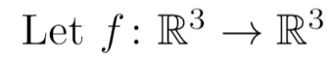
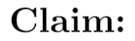
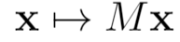
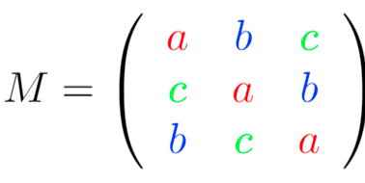
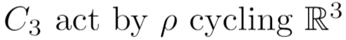
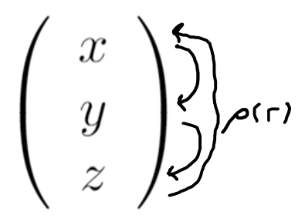
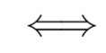
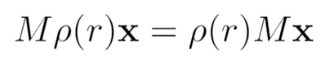
Warm up: C₃ -Equivariance By Weight Sharing
Q: Which M are equivariant?
Notes:
Linear function, act on the C3, general form of the map, find the
Also called circulant
9 -dimensional for general R3 - R3, 3 parameters reduce (linear + equivariant)

Slide 17
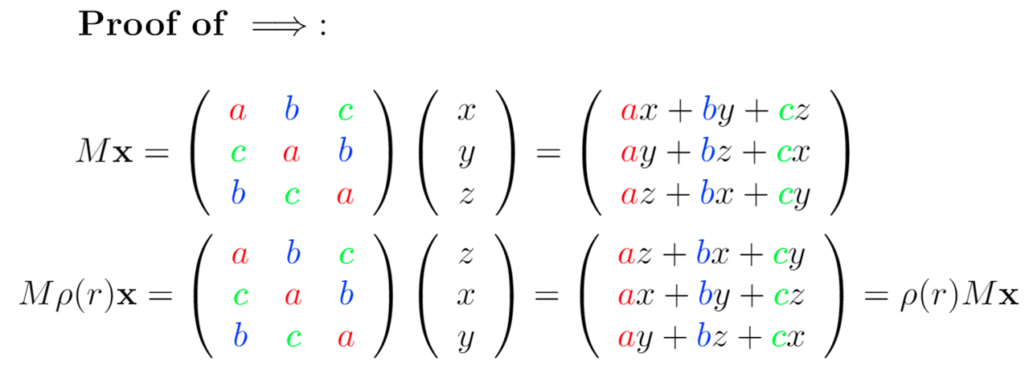
Warm up: C₃ -Equivariance By Weight Sharing
Notes:
Linear function, act on the C3, general form of the map, find the
Also called circulant
9 -dimensional for general R3 - R3, 3 parameters reduce (linear + equivariant)

Slide 18
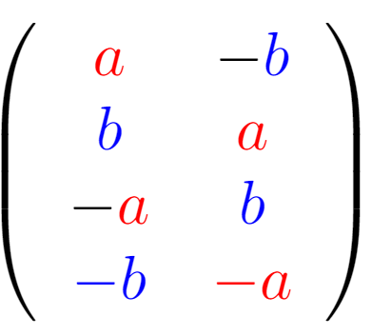
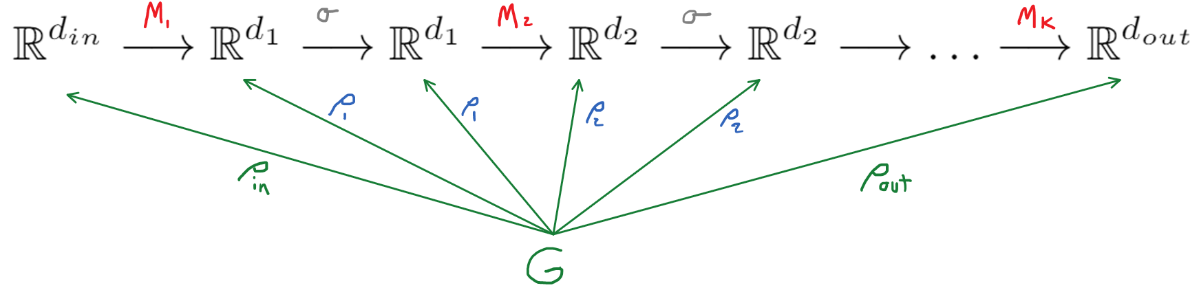
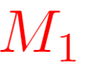
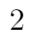
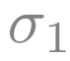
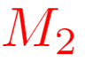
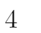

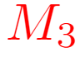
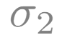
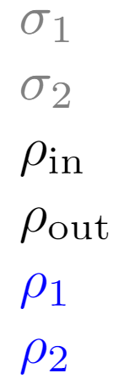

Equivariant Neural Networks
weight sharing
2
1
1
3
4
Equivariant Linear Layers and Equivariant Activations ⇒ Equivariant Network
Notes:
Having identified a symmetry in the task function, how do we build a neural network which respect this equivariance?
Here is a diagram for a neural network also going from R^{d_in} to R^{d_out} which we want to train to approximate f.
The network consists of alternating layers of linear mappings (denoted in red) and non-linear mappings.
In order to enforce equivariance, we simply enforce that all the layers are equivariant. Since the composition of equivariant functions is equivariant, the whole network will be as well.
Suppose R_{d_1} is R^2 and R_{d_2} is R^4. For an unconstrained NN this is a 4x2 matrix with 8 trainable parameters. Now we wish to restrict to the subspace of matrices which are equivariant with respect to these representations.
This gives a two-dimensional space of solutions with the following weight sharing pattern. Thus we have reduced the number of trainable parameters from 8 to 2.

Slide 19



Equivariant Neural Networks
Equivariant Linear Layers and Equivariant Activations ⇒ Equivariant Network
Notes:
We can check that transformation by the 4x4 matrix after applying this linear layer is equivalent to first applying the 2x2 rotation matrix and then the linear layer. The layer is thus equivariant.
An important consideration is activations also must be equivariant. With respect to the 2-d rotation matrix representation, the activation must be radial, that is, direction preserving.

Slide 20

Most Equivariant Architectures are all use some form of weight sharing
Notes:
Linear function, act on the C3, general form of the map, find the
Also called circulant
9 -dimensional for general R3 - R3, 3 parameters reduce (linear + equivariant)

Slide 21

Equivariant Neural Networks
true function
equivariant neural network functions
neural network functions
Equivariant neural networks narrow the search for the optimal model to smaller class of functions
Notes:
We now train our model by gradient descent.
This picture shows the space of all models with different parameter values for a given network architecture.
Our goal is to move through this space and find a model which is close to f.
Since we know the ground truth function is equivariant, by training within the space of equivariant neural networks, we are training within a smaller subspace of functions where we know the true function resides.
Thus we hope to find the true function faster or get closer to it, by virtue of narrowing the search space.
Instead of looking for a needle in a giant haystack, we are looking for a needle in a small haystack.

Slide 22

Whiteboard 1: Examples of Groups
Definition: Group
Definition: Abelian
Definition: Subgroup
Exercise: Write out symmetries of equilateral triangle
Example: $C_{n}$
Example:$Σ_{n}$
Example: O(2)
Notes:
We now train our model by gradient descent.
This picture shows the space of all models with different parameter values for a given network architecture.
Our goal is to move through this space and find a model which is close to f.
Since we know the ground truth function is equivariant, by training within the space of equivariant neural networks, we are training within a smaller subspace of functions where we know the true function resides.
Thus we hope to find the true function faster or get closer to it, by virtue of narrowing the search space.
Instead of looking for a needle in a giant haystack, we are looking for a needle in a small haystack.

Slide 23

Exercise
Which of the following is a group? Justify your answer.
$M_{n}\left(R\right)=\{ 3 x3$matrices with values in R}
$SL_{n}\left(R\right)=\{ n x n matrices$ with determinant 1 }
$Σ_{n}\left(2\right)=$ { permutations of 1,…,n fixing 2 }
$Σ_{n}^{fix 1}=\{$ permutations fixing exactly one element }
$G_{5}$ = { nxn matrices with |determinant| $≤2$}
Length-preserving transformations with fix a regular polygon
(N, m(a,b) = |a-b|) , N={0,1,2,…}
{0,1}, xor
$GL_{n}\left(R_{≥0}\right)=\{$invertible nxn matrices with non-negative entries}
(R^2 ,+)
([1,$∞$), $⋅$)

Slide 24
Whiteboard 2: Properties of Groups
Definition: Homomorphism, Isomorphism, Automorphism
Definition: Semidirect product
Example: E(2)
Notes:
We now train our model by gradient descent.
This picture shows the space of all models with different parameter values for a given network architecture.
Our goal is to move through this space and find a model which is close to f.
Since we know the ground truth function is equivariant, by training within the space of equivariant neural networks, we are training within a smaller subspace of functions where we know the true function resides.
Thus we hope to find the true function faster or get closer to it, by virtue of narrowing the search space.
Instead of looking for a needle in a giant haystack, we are looking for a needle in a small haystack.

Slide 25
Whiteboard 3: Properties of Groups
Definition: action, orbit, stabilizer
Examples: SO(2) on plane, Perms on elements, dihedral
Thm: orbit-stabilizer therorem
Definition: kernel, first iso theorem
Notes:
We now train our model by gradient descent.
This picture shows the space of all models with different parameter values for a given network architecture.
Our goal is to move through this space and find a model which is close to f.
Since we know the ground truth function is equivariant, by training within the space of equivariant neural networks, we are training within a smaller subspace of functions where we know the true function resides.
Thus we hope to find the true function faster or get closer to it, by virtue of narrowing the search space.
Instead of looking for a needle in a giant haystack, we are looking for a needle in a small haystack.

